Slide 1
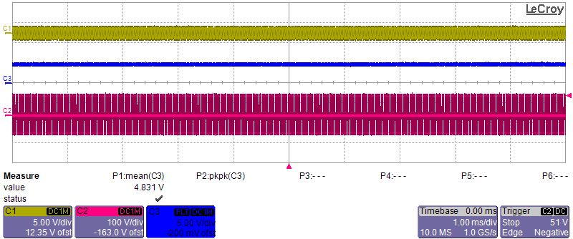
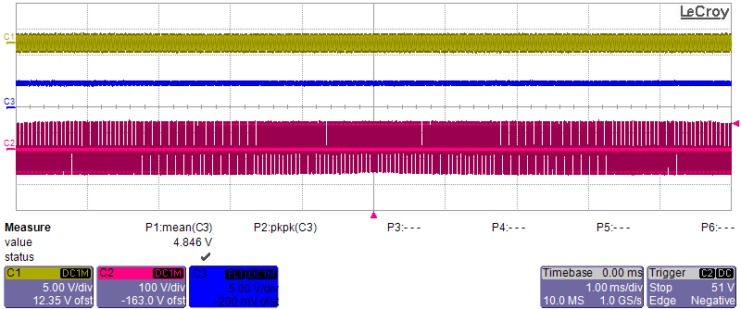
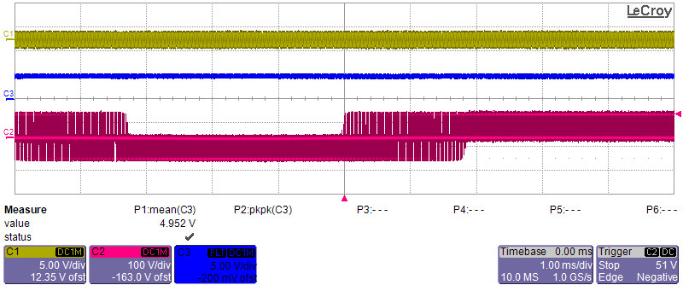
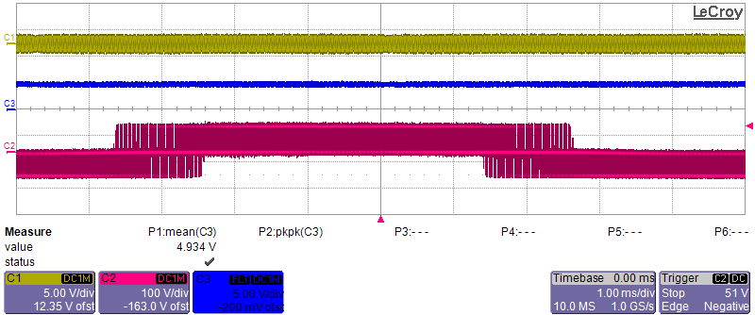
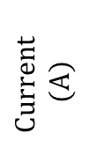
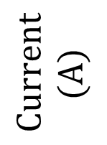
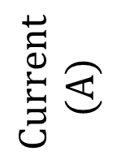
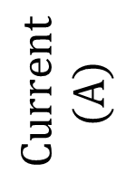
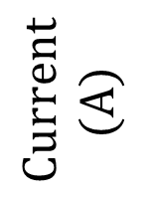
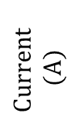

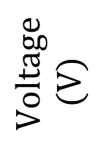

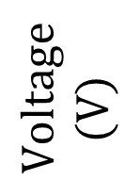
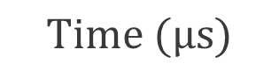
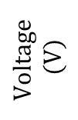

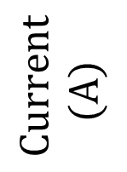
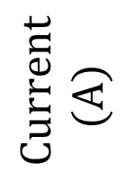

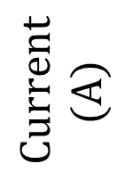

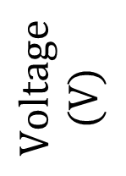


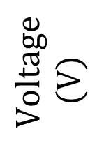
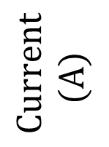
$$Current$$
$$(A)$$
$$Current$$
$$(A)$$
(a)
$$Current$$
$$(A)$$
$$Current$$
$$(A)$$
$$Voltage$$
$$(V)$$
$$Voltage$$
$$(V)$$
$$Current$$
$$(A)$$
(b)
$$Current$$
$$(A)$$
$$Voltage$$
$$(V)$$
$$Current$$
$$(A)$$
(c)
$$Current$$
$$(A)$$
$$Voltage$$
$$(V)$$
$$Current$$
$$(A)$$
(d)
$$Current$$
$$(A)$$
$$Voltage$$
$$(V)$$
$$C1$$
$$5 A/div$$
$$C2$$
$$100 V/div$$
$$C1$$
$$5 A/div$$
$$1 ms/div$$
$$Time (μs)$$
$$I_{F}$$
$$V_{AB}$$
$$I_{TX}$$

Slide 2

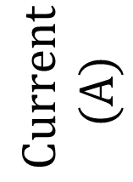
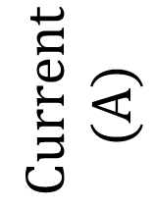
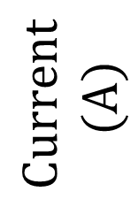

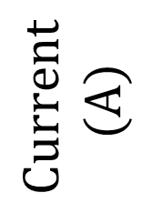
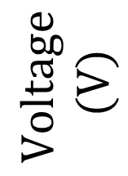
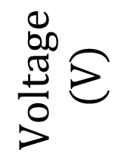
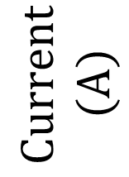
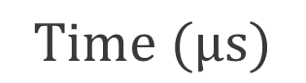

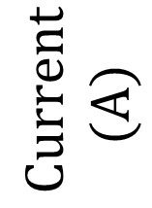
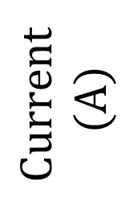
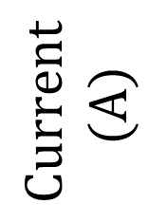

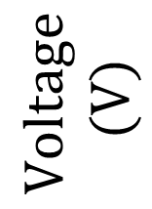


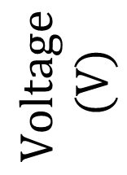

$$Current$$
$$(A)$$
$$Current$$
$$(A)$$
$$Voltage$$
$$(V)$$
(a)
$$Current$$
$$(A)$$
$$Current$$
$$(A)$$
$$Voltage$$
$$(V)$$
(b)
$$Current$$
$$(A)$$
$$Current$$
$$(A)$$
$$Voltage$$
$$(V)$$
(c)
$$Current$$
$$(A)$$
$$Current$$
$$(A)$$
$$C1$$
$$5 A/div$$
$$C2$$
$$100 V/div$$
$$C3$$
$$5 A/div$$
$$Voltage$$
$$(V)$$
(d)
$$1 ms/div$$
$$Time (μs)$$
$$I_{TX}$$
$$V_{AB}$$
$$I_{F}$$

Slide 3
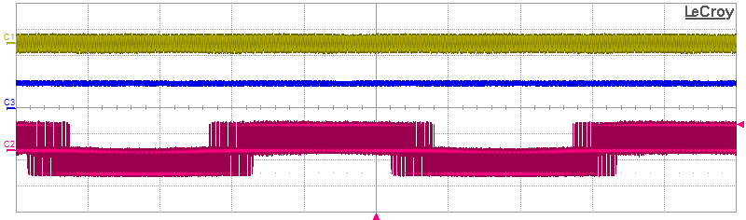
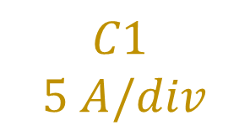






(a)
$$C1$$
$$5 A/div$$
$$C2$$
$$100 V/div$$
(b)
$$C3$$
$$5 A/div$$
$$1 ms/div$$
$$I_{TX}$$
$$V_{AB}$$
$$I_{F}$$

Slide 4
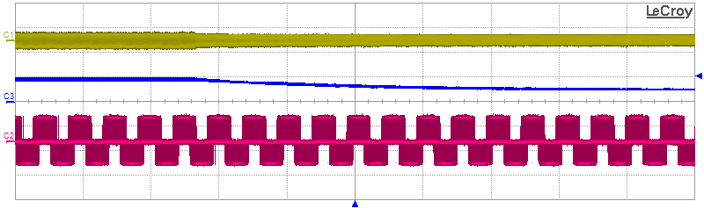

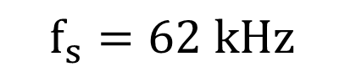





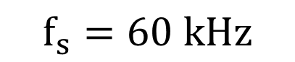

$$f_{s}=60 kHz$$
$$f_{s}=62 kHz$$
$$C1$$
$$5 A/div$$
$$C2$$
$$100 V/div$$
$$C3$$
$$5 A/div$$
$$20 ms/div$$
$$I_{TX}$$
$$V_{AB}$$
$$I_{F}$$

Slide 5
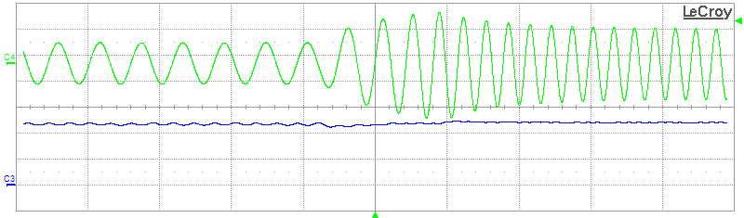




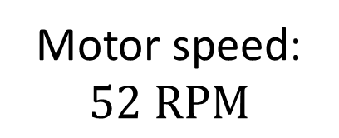
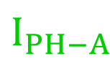
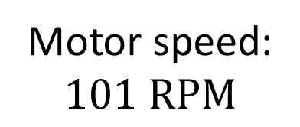

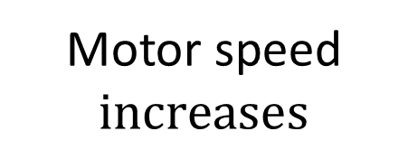

Motor speed:
$$52 RPM$$
Motor speed
$$increases$$
Motor speed:
$$101 RPM$$
$$I_{F}=4.7 A$$
$$I_{F}=4.8 A$$
$$C3$$
$$2 A/div$$
$$C4$$
$$2 A/div$$
$$1 s/div$$
$$I_{F}$$
$$I_{PH−A}$$

Slide 6
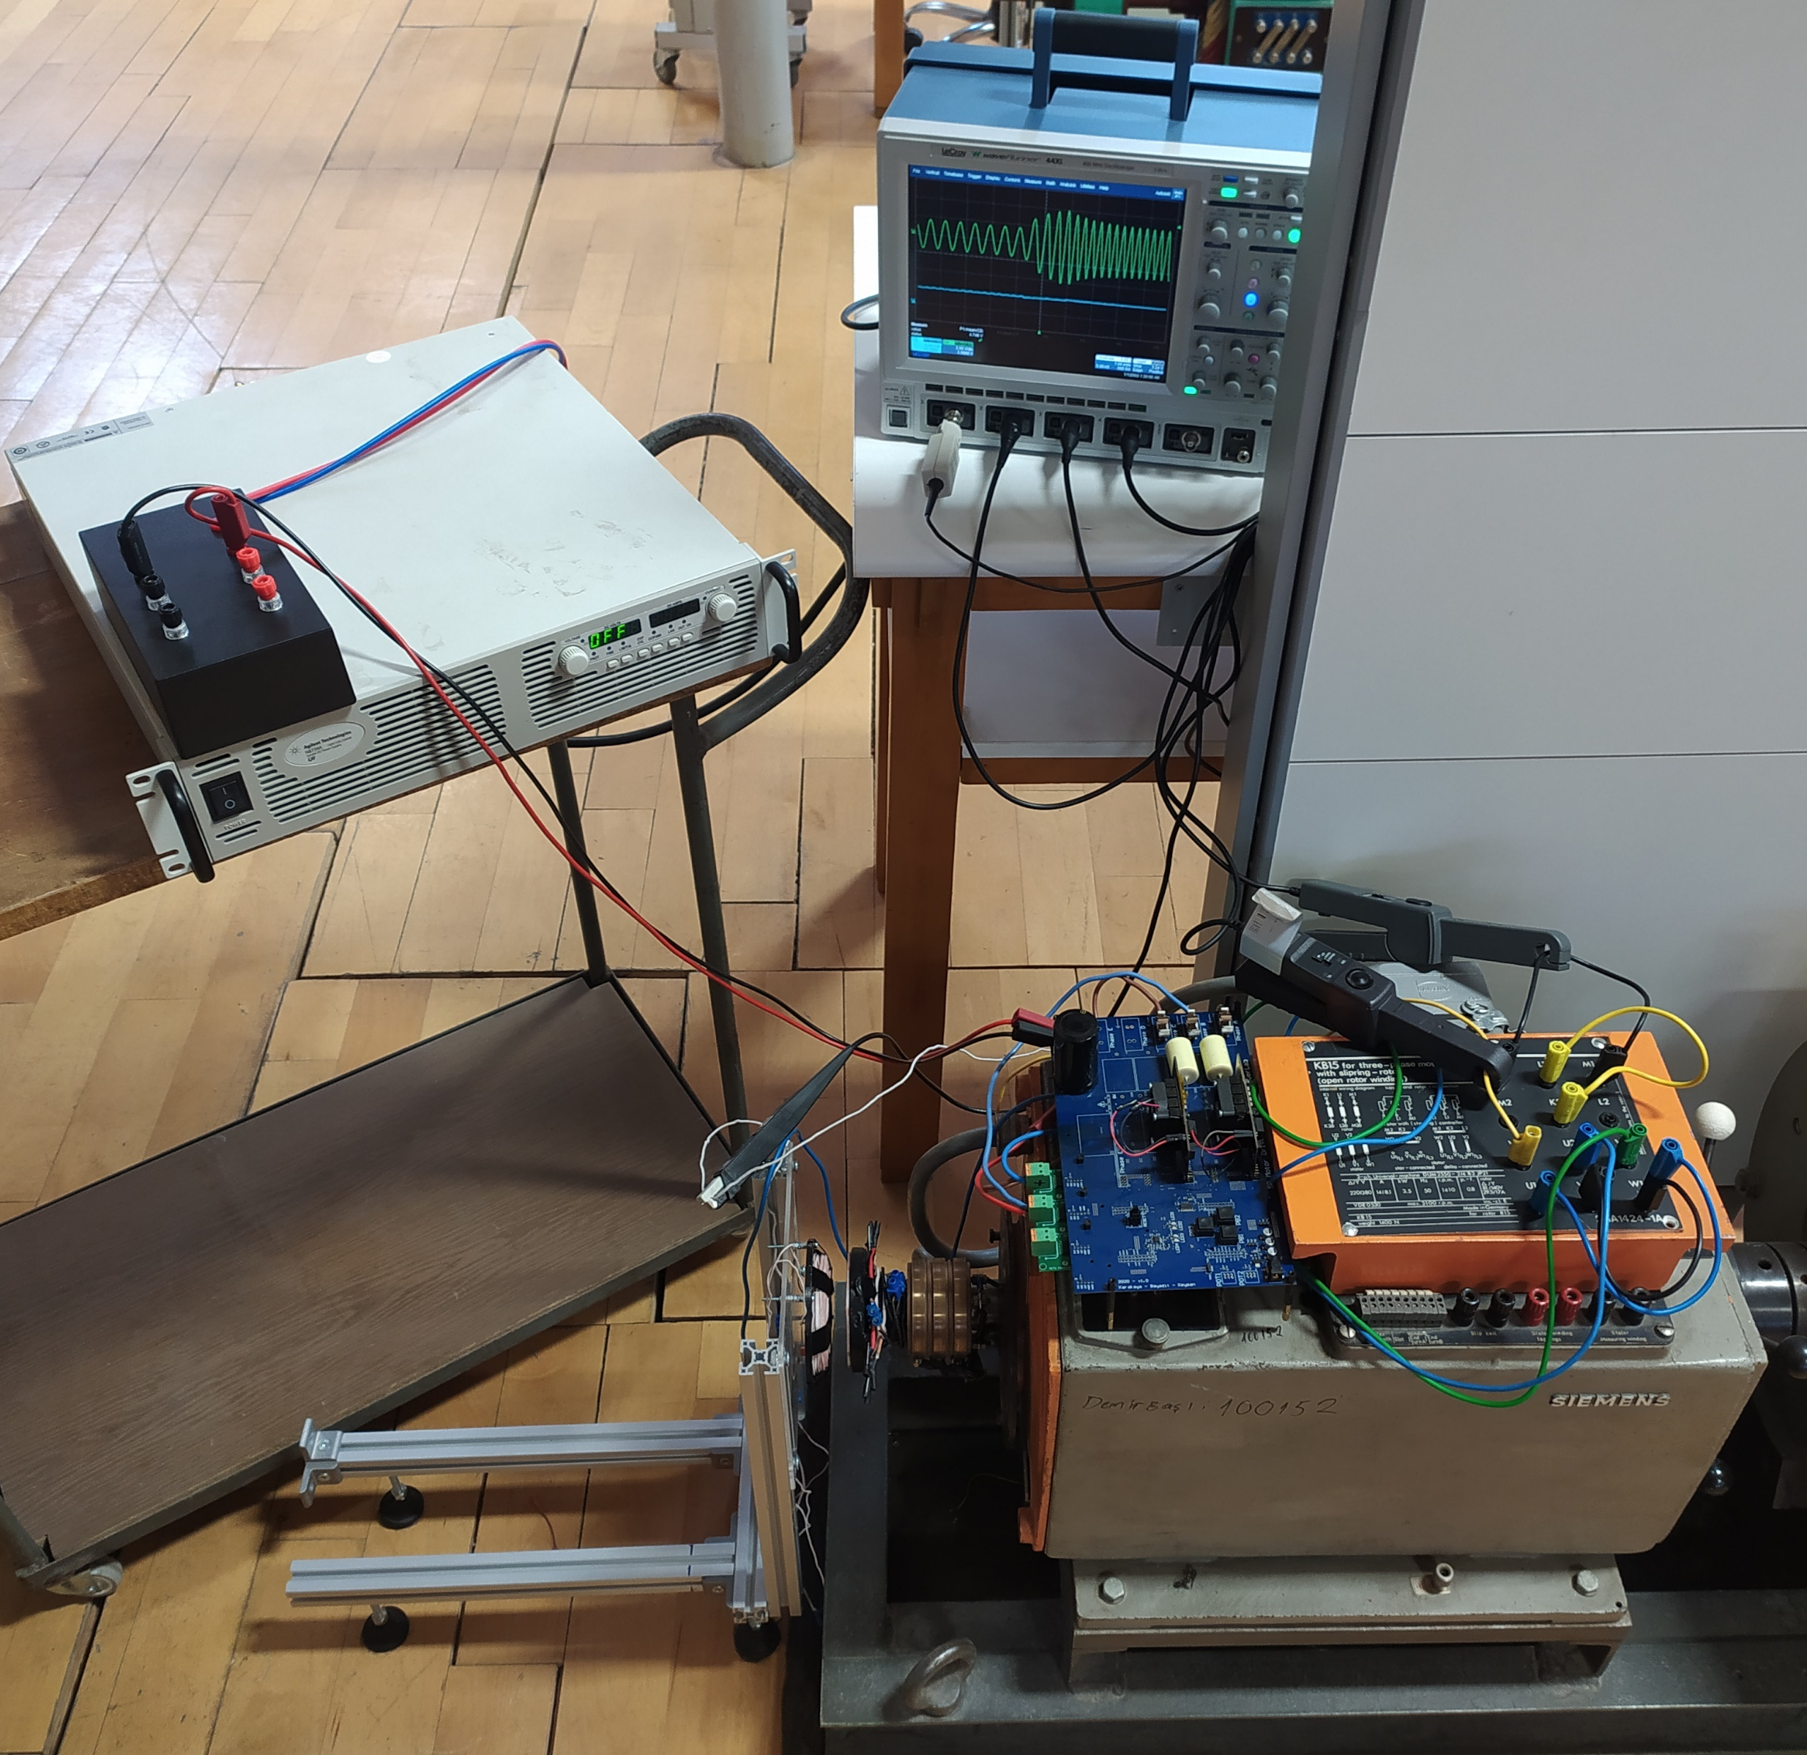
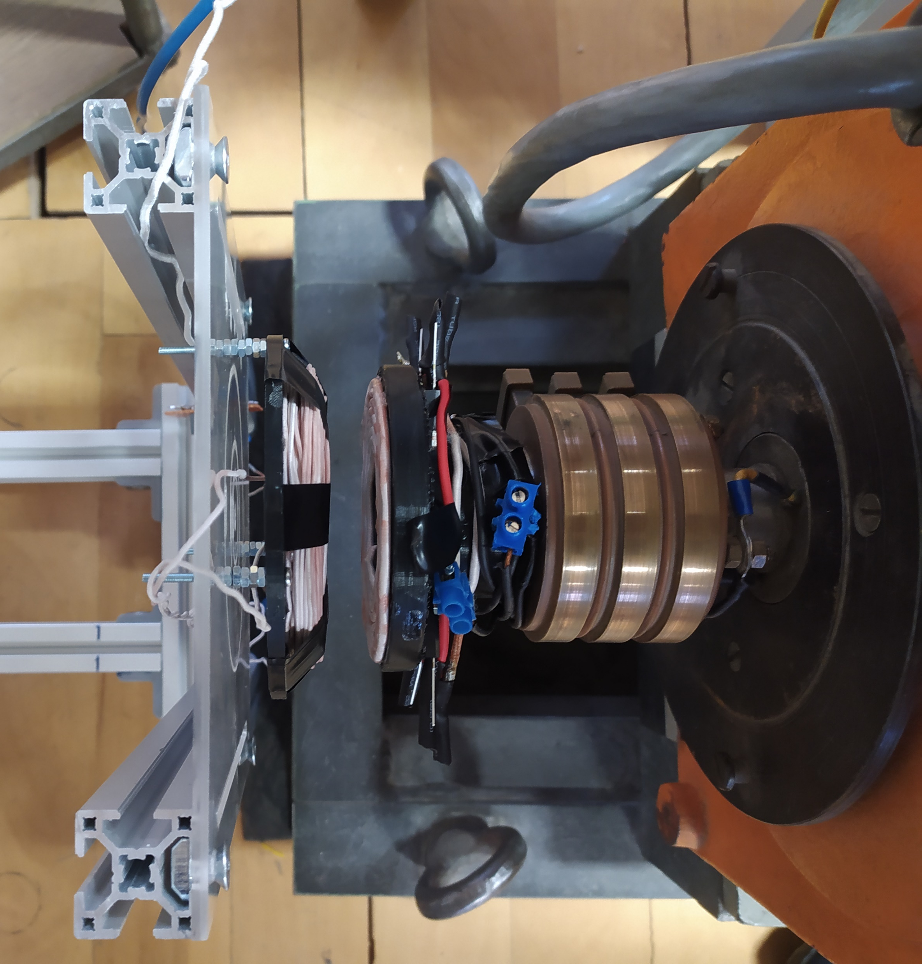
Oscilloscope
Stationary
Tx coil
Rotating Rx coil
Rotating diode rectifier
Motor drive
Current probes
Current probe
DC supply
Contactless field excitation system
(b)
Electrically excited synchronous motor
(a)

